Slide 1

Calorie Track PRO
An app to track your calorie intake to meet your specific calorie count goal.
Eugene Kirima
Hayoung Cheon
Uriel Cohavy

Slide 2
Table of contents
01
02
03
04
05
06
07
08
About the Project
User
Stories
Tech
Stack
Database
ERD
Wireframes
Demo
Challenges
Handoffs

Slide 3
01
About the Project

Slide 4

Project Description
Help users track their calorie intake to meet their calorie count goals and maintain their health.
Notes:
- The project’s objective is to help users track their calorie intake to meet their calorie count goals and maintain their health.

Slide 5
Key Features
User Authentication
Profile
Management
BMI Calculation
Admin Functions
Calorie
Calculation
Daily & Weekly
Calorie Monitoring
Notes:
- The key features are:
•User authentication and profile management.
•BMI calculation.
•Calorie calculation.
•Daily and weekly calorie count monitoring.
•Admin functionality for food database management.

Slide 6
02
User Stories

Slide 7
User Stories
Users can register and create user accounts.
User can log in and log out from their accounts.
User can create a profile with the following information
: gender, height, weight, activity levels and calorie goals
User can view their profile information
User can edit/delete their profile.
User can view their BMI calculation (calculated from their profile details)
User can search for foods in database and enter the food they have eaten to
Track the number of calories taken per meal per day
User can view or monitor their daily calorie intake and goal in the calorie track view dashboard
Users can monitor their intake progress weekly.
Admin can add, update and delete foods in the food data.
Admin can access and manage users .
Notes:
- The project’s objective is to help users track their calorie intake to meet their calorie count goals and maintain their health.

Slide 8
03
Tech Stacks

Slide 9










Tech Stacks
Frontend
Backend
DB/API
Postgre
SQL
React JS
HTML
CSS
Java
Spring boot
Spring MVC
Spring REST
Spring DATA JPA
Aws
RDS
React
Bootstrap
Maven
Bootstrap

Slide 10
04
Database
ERD

Slide 11
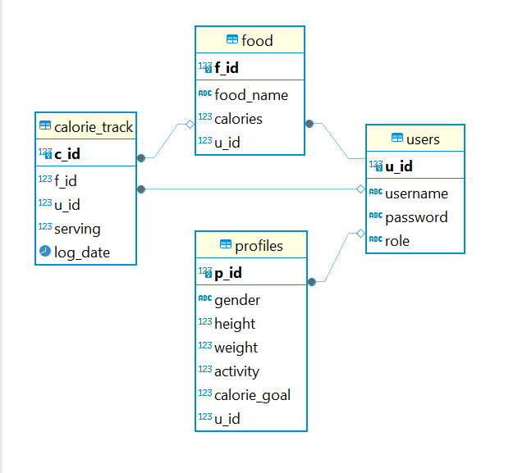
Calorie-track-database ERD

Slide 12
05
Wireframes

Slide 13
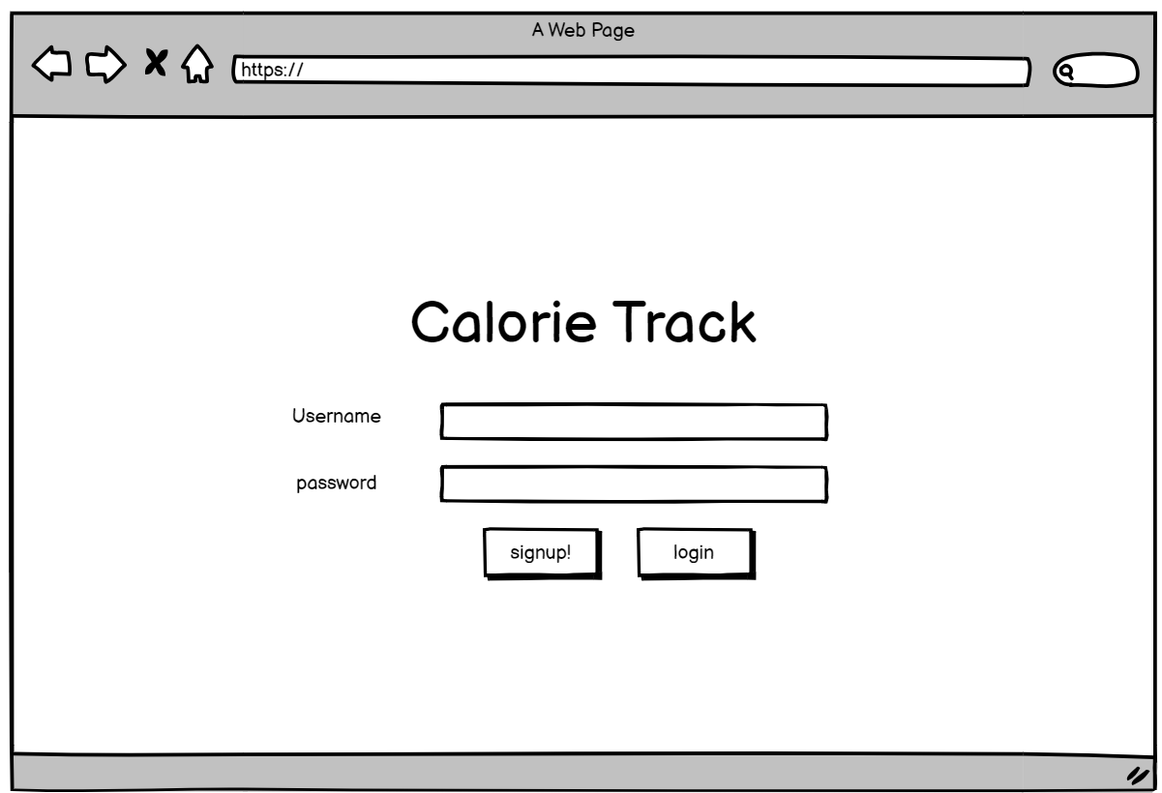
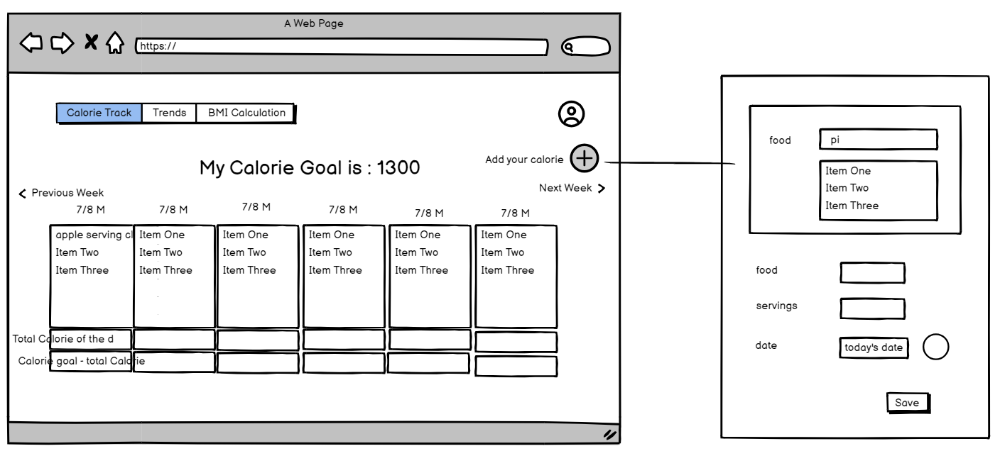
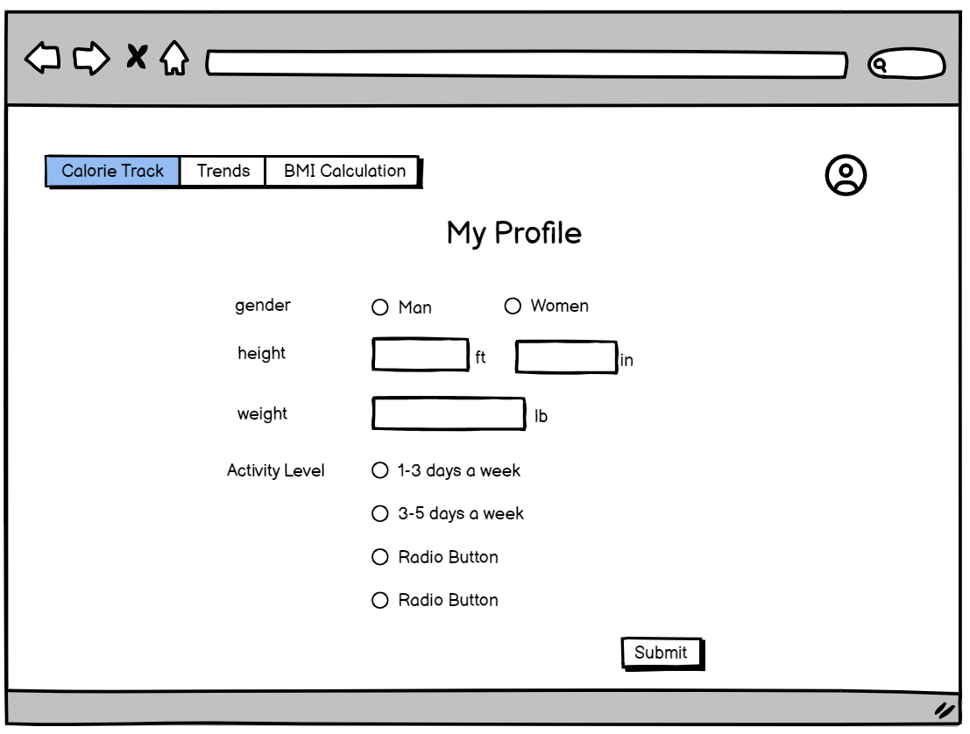
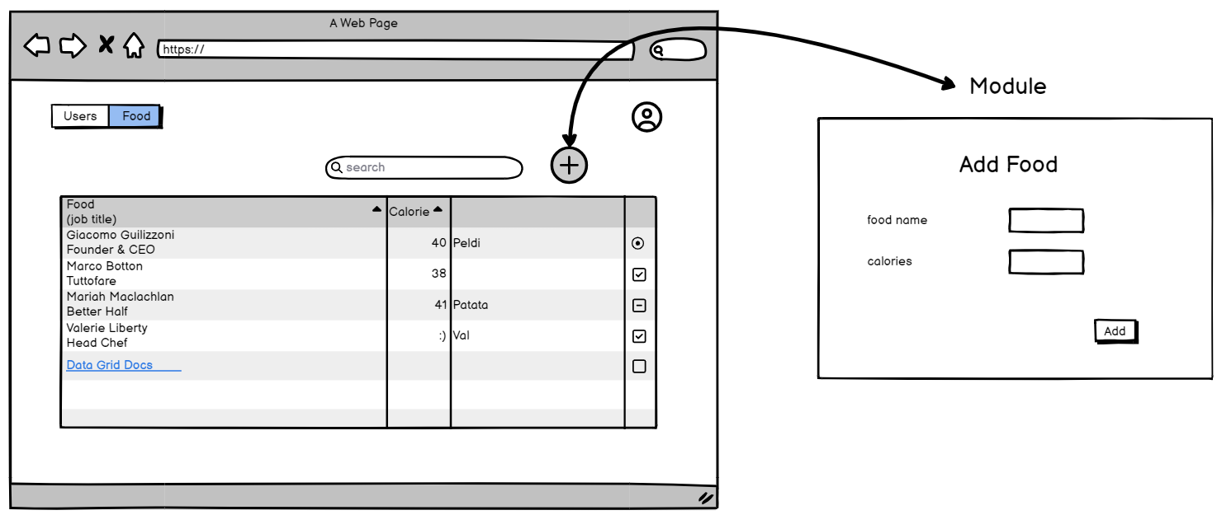
Wireframes

Slide 14
06
Demo

Slide 15
07
Challenges

Slide 16
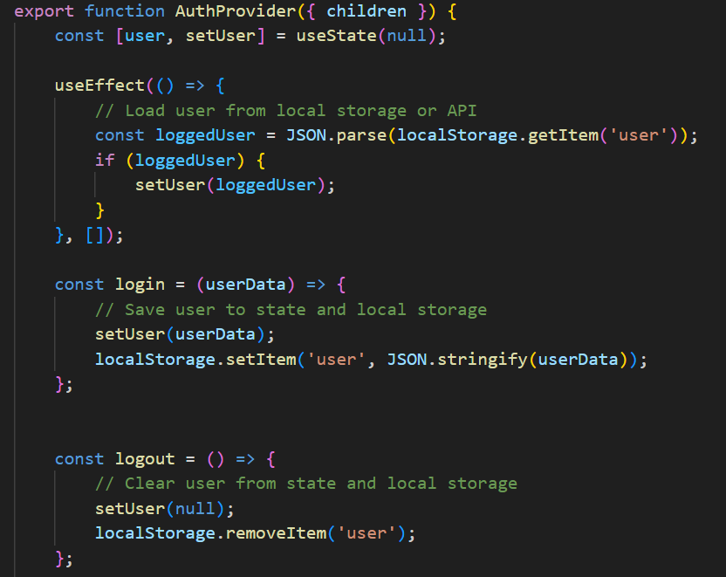
Challenges
Storing User
Information
Every Refresh would erase user’s information
Save at local storage.

Slide 17
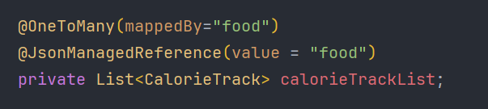
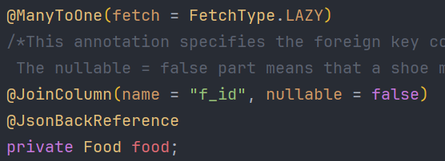
Challenges
Models.Food
FindAllFoodItems
Models.CalorieTrack
StackOverFlow Error
Redefined the relationship between uscalorietrack and food

Slide 18
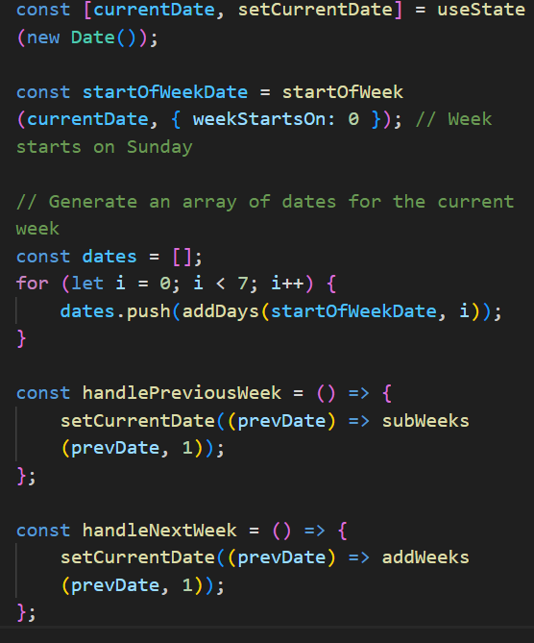
Challenges
Weekly Table
A Logic Problem
Through Research,
Learned lots of npm libraries

Slide 19
08
Handoffs

Slide 20
Handoffs
Calorie trends
Secure User Authentication
By using Spring Security
A simple statistics of weekly and monthly calorie intake
Graphs or Charts of it.
Food Public API
Healthy Recipe by AI API
For more Data
Custom food track in calorie log.
Generating Healthy Recipe
By using Generative AI API

Slide 21
Thanks!
Do you have any questions?
Please keep this slide for attribution

Slide 22


